Slide 1
XYZ Company Industry Project
Levi Watson
Troy Rodriguez

Slide 2
Outline
Project Overview
Research Questions
Dataset
Methods
Results
Recommendations
Conclusion

Slide 3
Project Overview
The XYZ Company Market Intelligence Team wanted us to analyze key Economic Indicators and determine correlations with their revenue, and other markets.
Interested in Recession impact as well.

Slide 4
Research Questions
Which indicators help predict declines or increases in revenue for XYZ Company?
How have these indicators moved compared to past recessions?
Which is better? Seasonally Adjusted or not?

Slide 5
Dataset
Sales Data:
Electronic Sales
XYZ Company Revenue
Total Retail & Food Service Sales
Total Retail (Excluding Auto Sales)
Non-Store Retail
Quarterly -> Monthly

Slide 6
Dataset
Socio-Economic Indicators:
GDP
PCE
S&P 500
Unemployment
Rate
Claims
Average Hourly Earnings
CPI
Available Credit
Disposable Income
CCI
Debt
Savings Rate
Home Sales
New
Preowned
Plans to Buy an Automobile
Monthly Data
Year-over-Year Transform as necessary
Lagged and Leading Variables

Slide 7
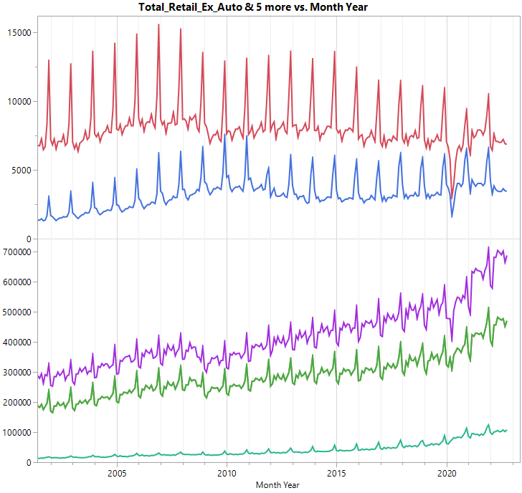

Slide 8
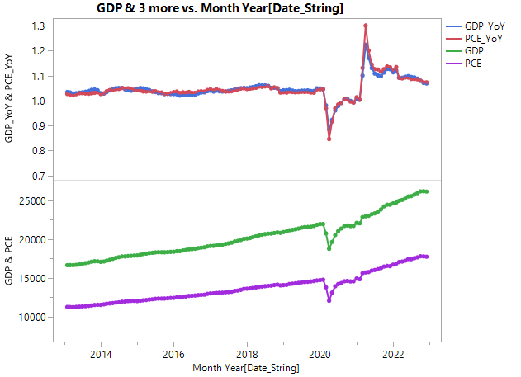

Slide 9
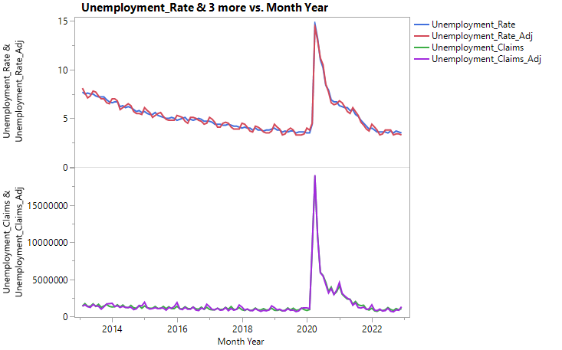

Slide 10
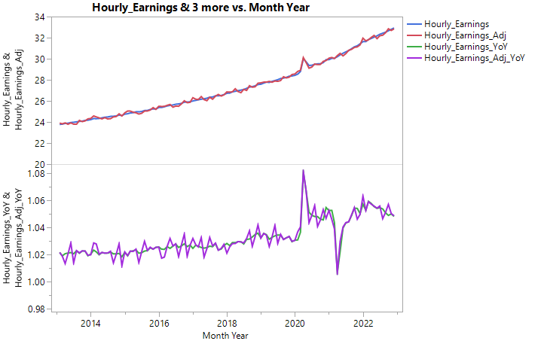

Slide 11
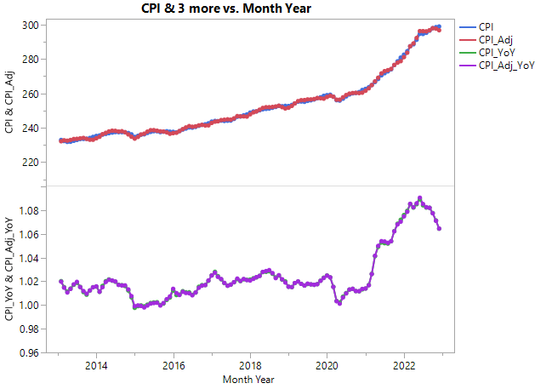

Slide 12
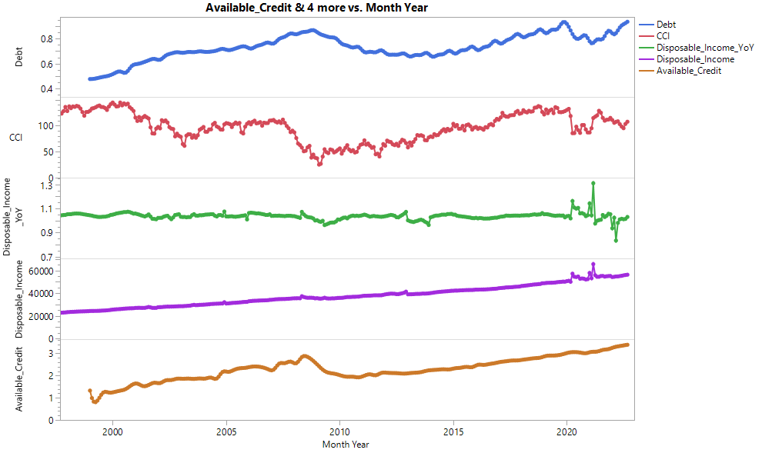

Slide 13
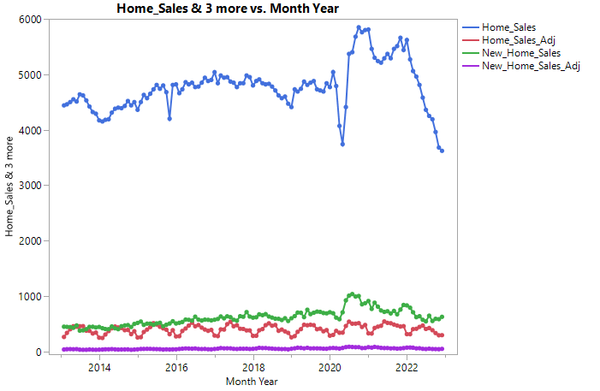

Slide 14
Redacted
Correlation Plot
High correlation between similar Variables
Low Correlation with Response

Slide 15
Methods
Predictive model for sales revenue
Recurrent Neural Network (RNN)
Prescriptive model for building Intuition for change in XYZ Company Revenue
Regression with ARIMA Errors
Visual Grouping of Past Recessions
Cluster Analysis on Functional PCA

Slide 16
Lags and Leads
A Lag of 1 for this month is last month
A Lead of 1 for this month is next month
Ex. The Covid Recession has a lead on Revenue
The recession happened, and then Revenue reacted.

Slide 17
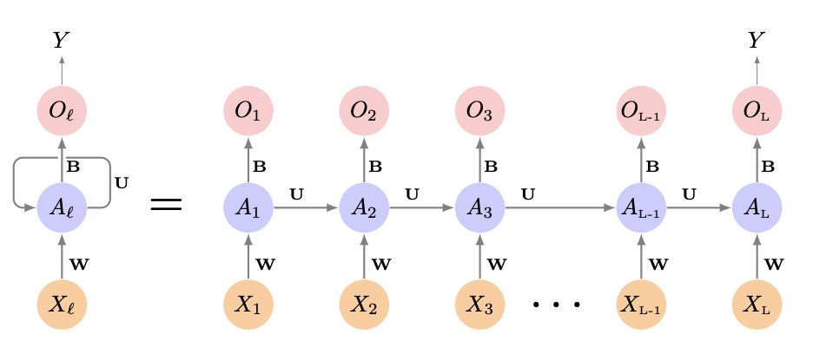
RNN (Overview)
Neural Network – Order Specific
Generally Used in Time Series or NLP
Strengths
Weaknesses

Slide 18
RNN (Inputs)
Inputs:
GDP Year over Year
Disposable Income
Disposable Income Year over Year
Home Sales, Seasonally Adjusted
New Home Sales, Seasonally Adjusted
Plans to Buy an Automobile
Unemployment Rate, Seasonally Adjusted
Unemployment Claims, Seasonally Adjusted
Savings Rate
Recessions
Month
Training Data:
Economic Factors: 1992-2020
Monthly Revenue: 1993-2021
Testing Data:
Economic Factors: 2021
Monthly Revenue: 2022
Forecasting Data:
Economic Factors: 2022
Monthly Revenue: 2023

Slide 19
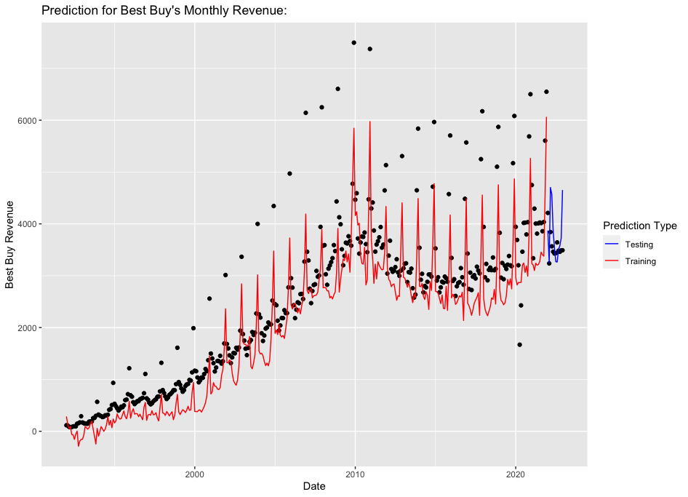
Model Performance
Performance on Testing Data:
Coefficient of Variance of 14.64.
Red: Prediction for Training Data
Blue: Prediction for Testing Data

Slide 20
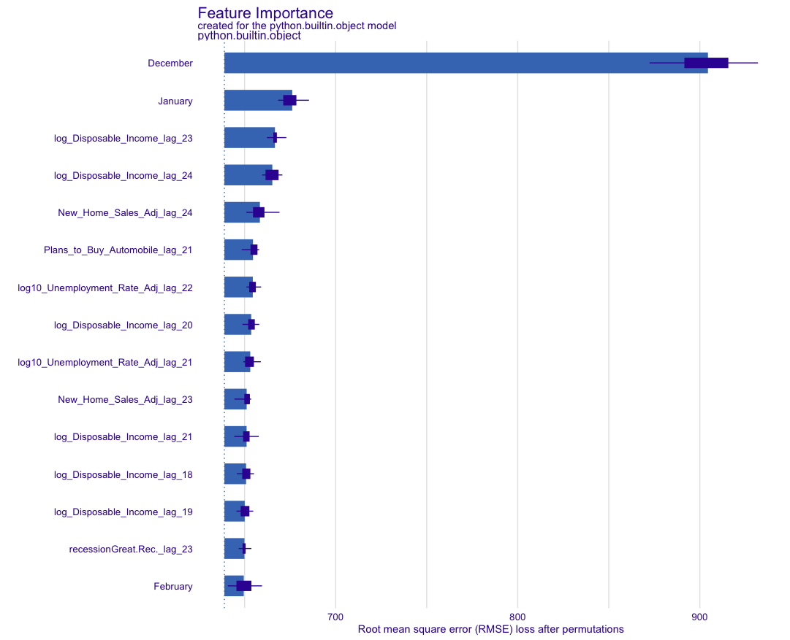
Important Features
Important Features:
Seasonal (Months)
December, January, and February
Disposable Income
Lags 18, 19, 20, 21, 23, 24
New Home Sales
Lags 23, 24
Unemployment Rate
Lag 21, 22
Plans to Buy Automobile
Lag 21

Slide 21
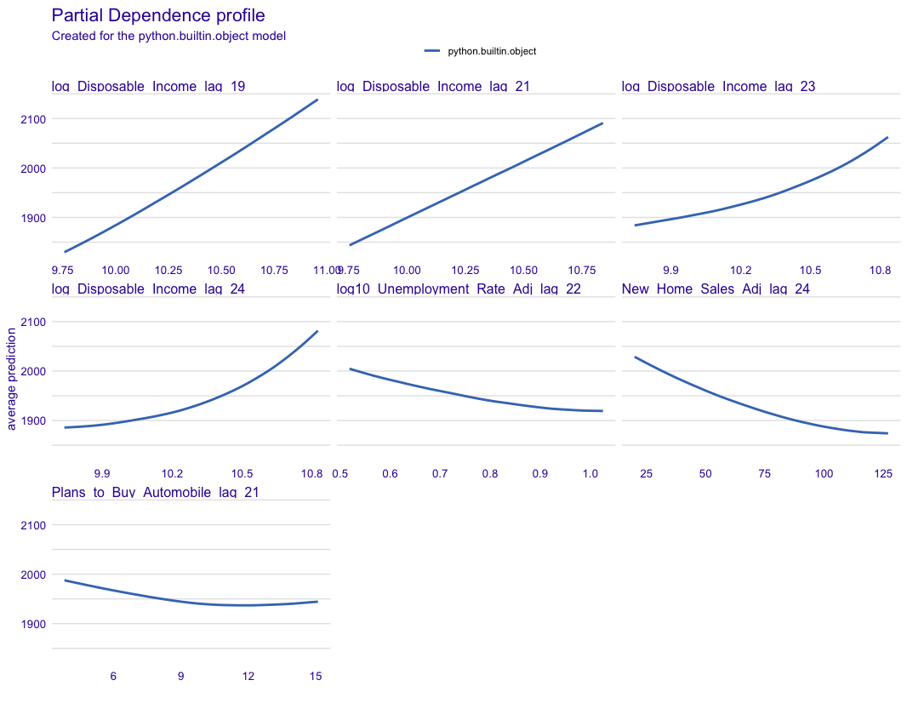
Effects on Prediction
Partial Dependence Profiles:
(How average prediction is affected by key variables.)

Slide 22
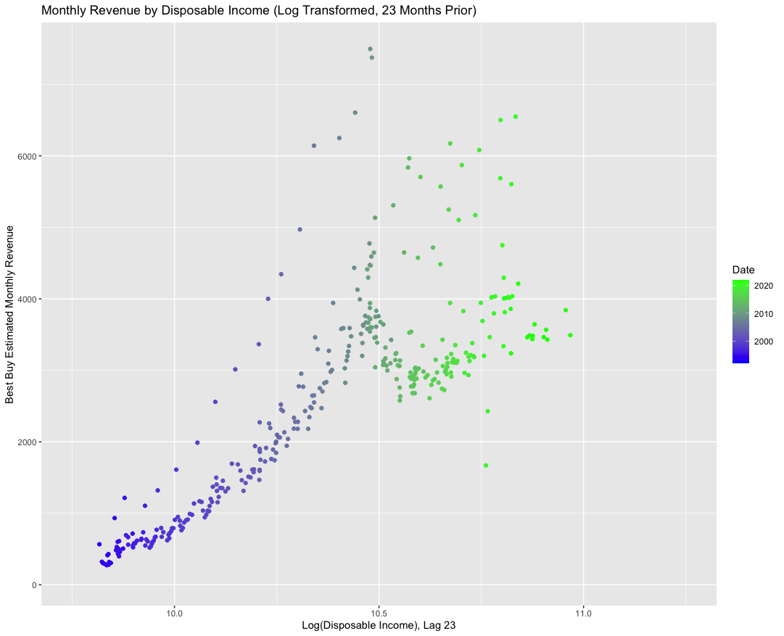
Disposable Income
Monthly Revenue vs. Disposable Income:

Slide 23
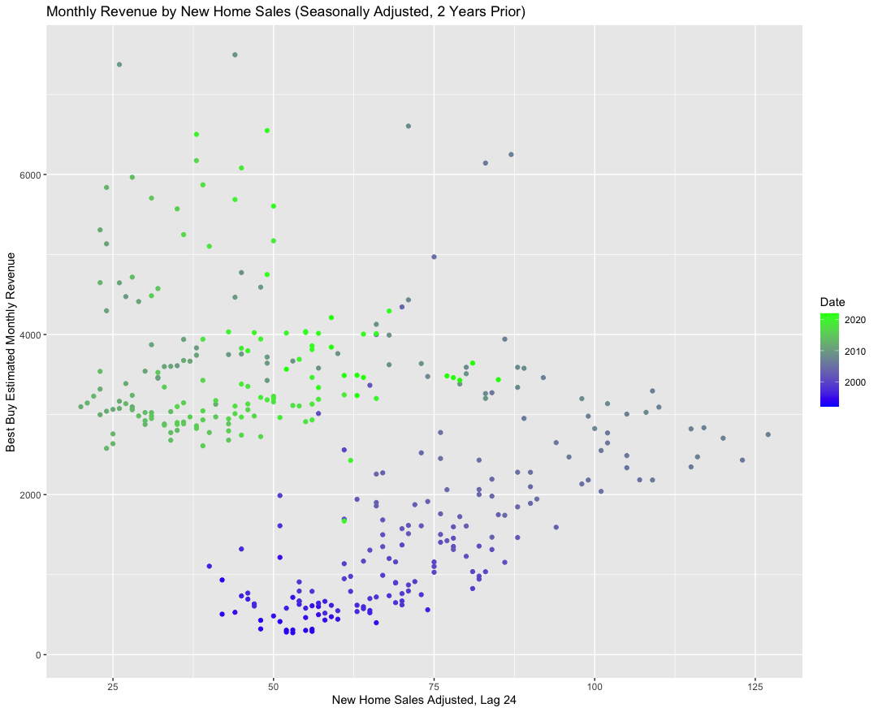
New Home Sales
Monthly Revenue By New Home Sales (Seasonally Adjusted):

Slide 24
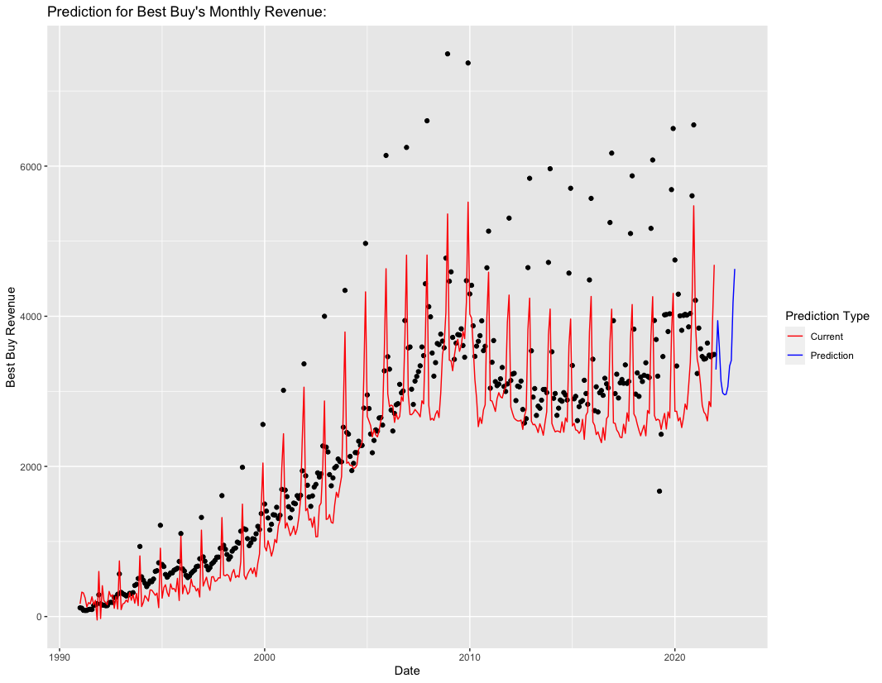
Prediction
Prediction for 2023's Monthly Revenue:

Slide 25
Prescriptive Model
Use Regression with ARIMA Errors
Model the Curve, then the Errors.
Predictors used to provide intuition

Slide 26
Predictor Scope
Socio-Economic Predictors
24 Month Window for Lags/Leads
Month Indicators
Recession Indicators
Interaction Terms

Slide 27
Regression Predictors - Indicators
Is November
Coefficient: -11%
Is December
Coefficient: 7.5%
Explains Q4 Holiday sales
“Is November” is negative due to Interaction Term

Slide 28
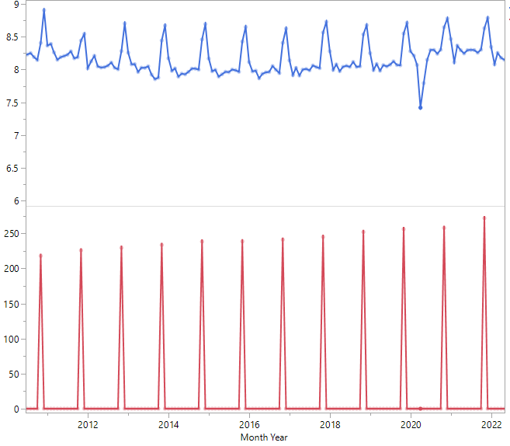
CPI Adjusted 5 Months prior crossed with Is November
Coefficient: +.06%
Helps capture the seasonal spike.

Slide 29
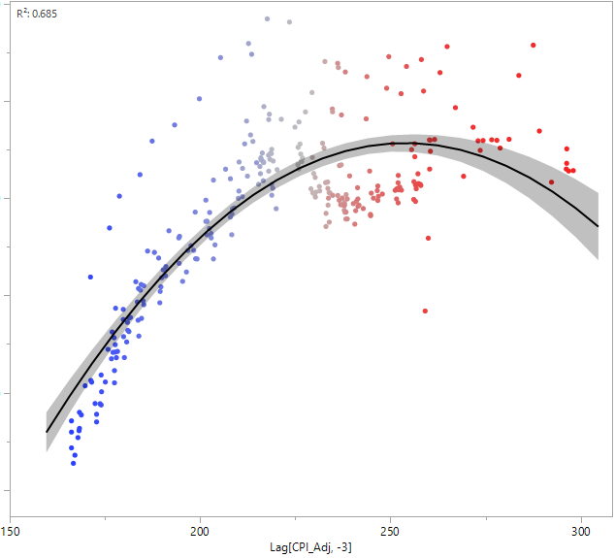
Predictors
CPI Adjusted
Lead 3
Coefficient: +1.2%
CPI Adjusted Squared
Lead 3
Coefficient: -0.0026%
Captures general trend
Squared term to help explain non-linearity

Slide 30
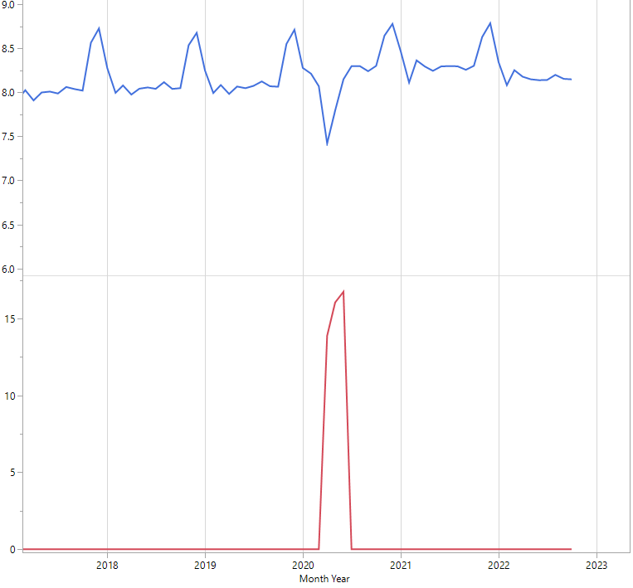
Ln(Unemployment Claims Adjusted) Two months ahead crossed with Is Covid Recession 3 Months Prior
Coefficient: -0.22%
Main Effects Insignificant
One of many ways to account for drop in revenue
High collinearity for Unemployment Claims

Slide 31
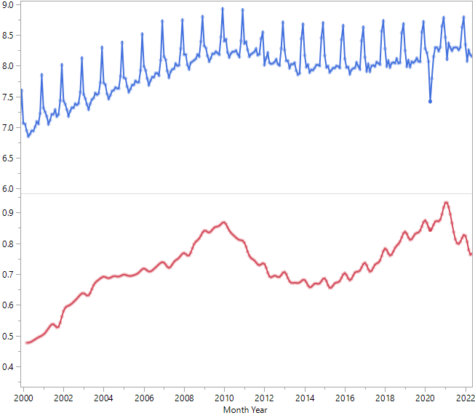
Debt
14 Months ago
Coefficient: +20.4%
Direct, but incomplete relationship

Slide 32
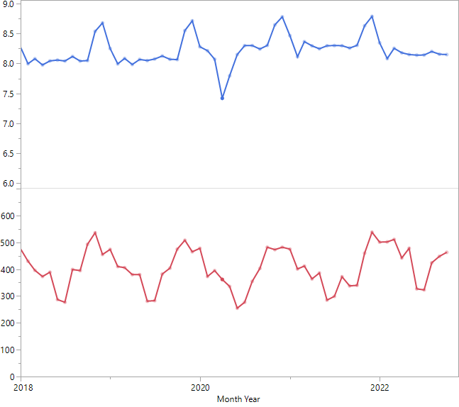
Home Sales Adjusted
17 Months ago
Coefficient: +0.0065%
Increase in Existing Home Sales -> Increase in Revenue
More Home sales during summer months
Lag lines up with Q4

Slide 33
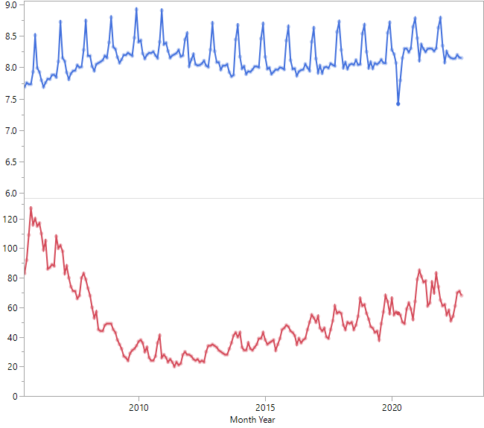
Predictor
New Home Sales Adjusted
Lag 7
Coefficient: -0.28%
General Opposite Trend

Slide 34
Comparing Recessions
Data Explained using Functions (Functional PCA)
Visualize/Compare Recessions

Slide 35
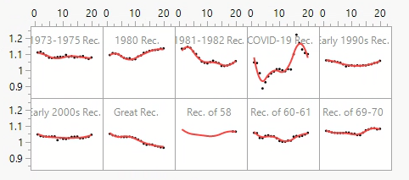
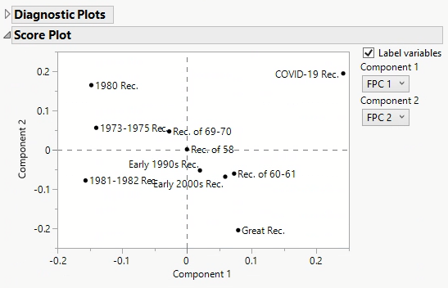
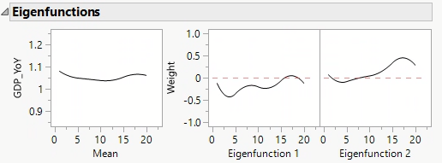
Functional PCA
GDP Year-over-Year:

Slide 36
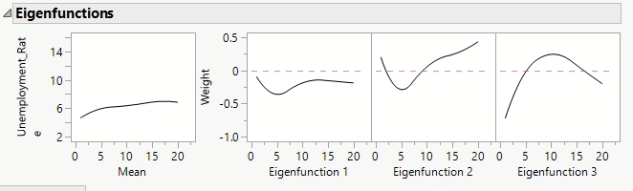
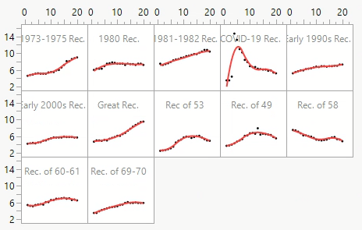
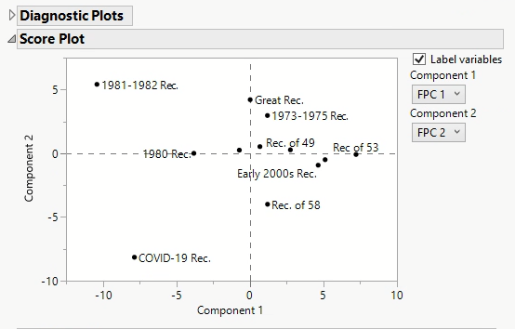
Functional PCA
Unemployment Rate:

Slide 37
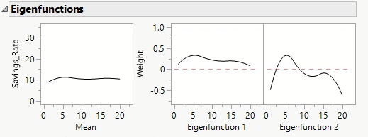
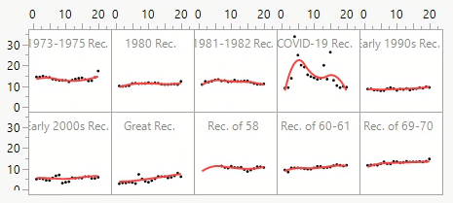
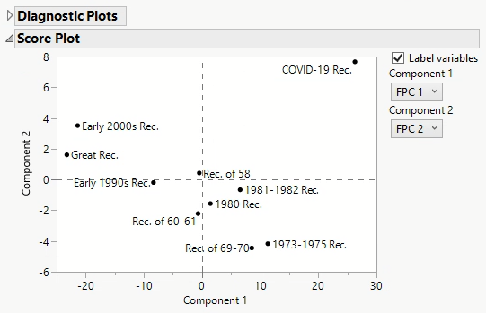
Functional PCA
Savings Rate:

Slide 38
Conclusion
Research Questions Answered?:
Which indicators help predict declines or increases in revenue for XYZ Company?
New and Existing Home Sales
Disposable Income
Debt
Q4 or not
CPI Adjusted x November
How have these indicators moved compared to past recessions?
COVID-19 Recession was much different than previous.
Which is better? Seasonally Adjusted or not?
Seasonally Adjusted Variables

Slide 39
Recommendations
Apply RNN Model for Predictions
Watch significant variable for general idea direction of Revenue.

Slide 40
Questions?

Slide 41
Appendix

Slide 42
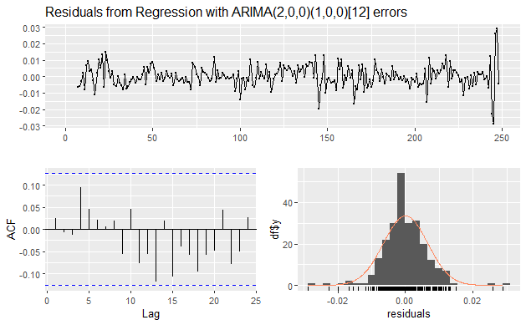
Regression with ARIMA Errors

